Slide 1
FOOD FRIENDS
Total Time: 8 min per group

Slide 2
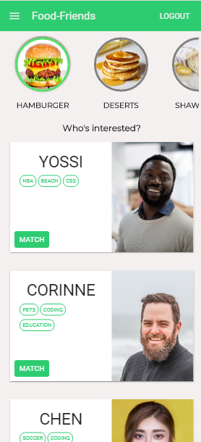
WHAT WE DO
Food Friends is a social platform surrounding food culture. We provide our users the ability to socialize & find people to share a foodie experience with.

Slide 3
The Problem
Ever did you eat a sidh so amazing and wanted to share it with someone who can appreciate the delicacy of it?
The Solution
We provide our users the ability to socialize & find people to share a foodie experience with.

Slide 4

Technology
Back End - Node.js - Express Server - Mongo DB - Socket.io - Validator - Random Avatar API
Front-End - React - MobX State Manager - CSS3 Animations - Material UI - React Spring for Page Transitions - React Facebook Login - React Chat

Slide 5



Architecture - General
Return users info (only online users)
Register as a new user and search for other users
Store user info & query DB
Return matched user info (only online users)
Notes:
Here is the chance to mention new stuff you’ve learned!!

Slide 6
Architecture - Match with a User
Send a match notification.
Select a user to match with.
Store match info

Slide 7
Architecture - Chat
Communicate message to other client
Send a message
Store conversation info

Slide 8
Live DEMO
Notes:
Choose the most interesting features. The core
Max: 1 min.
Recorded Demo

Slide 9
Challenges
Live chat & live match notifications
Using data from both Database & Socket.io on Client

Slide 10
What’s Next
Adding a “Top Foodies” section for people who are popular
Adding interest recommendations on signup
Adding restaurant recommendations on match

Slide 11
THANK YOU!

